Slide 1
Loan application screening and aspect of Fair lending practice
By :-
Sujeet Ghorpade
Kishor Lagad
Vinayak Boralkar
Sagar kale
Project Guide
Komal kothawade

Slide 2
Motivation
Main product of banking sector is loan
Effective business strategy building
Maintain a relationship with genuine customers

Slide 3
Objectives
1. As a decision maker, looking into these given booked accounts, how would you want to take a decision to approve/ decline the same applications again in future? What would be your screening criterion(s), if any?
2. Providing data driven rationale to substantiate the appropriateness of the characteristics you have identified in the screening logic
3. Given that you have a decision engine, which helps you to take a call based on the given data, how would you identify if your process has an unintentional bias and discriminate your customers based on some of the sensitive attributes

Slide 4
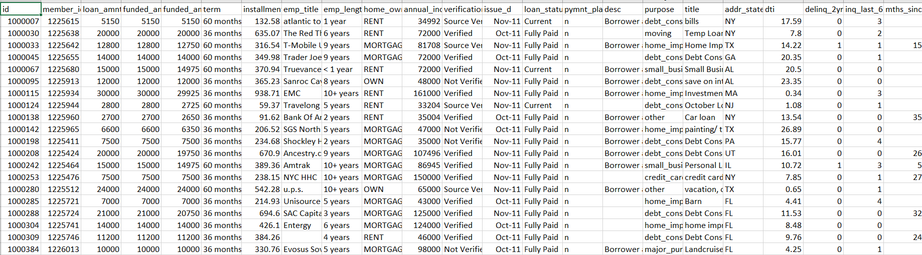
Introduction to dataset
Inside the following dataset, there are around 42,000 loan accounts, booked in between 2007 to 2011, with some demographic and credit bureau attributes along with current loan status.
It is critical that lenders don’t base their decisions which may come across as biased and unfair on account of a customer’s race, religion, nation of origin, gender, and age etc

Slide 5
Software
Python
Tableau

Slide 6
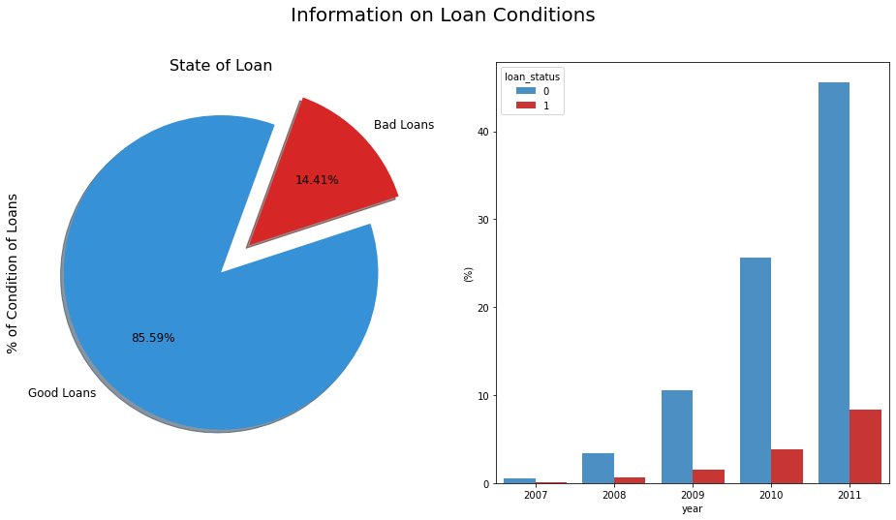
Explanatory analysis

Slide 7
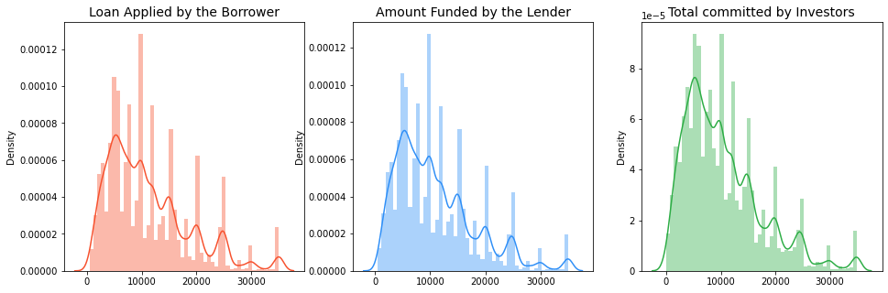

Slide 8
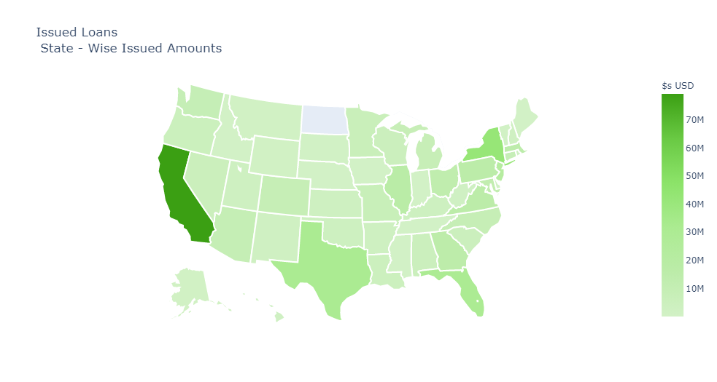
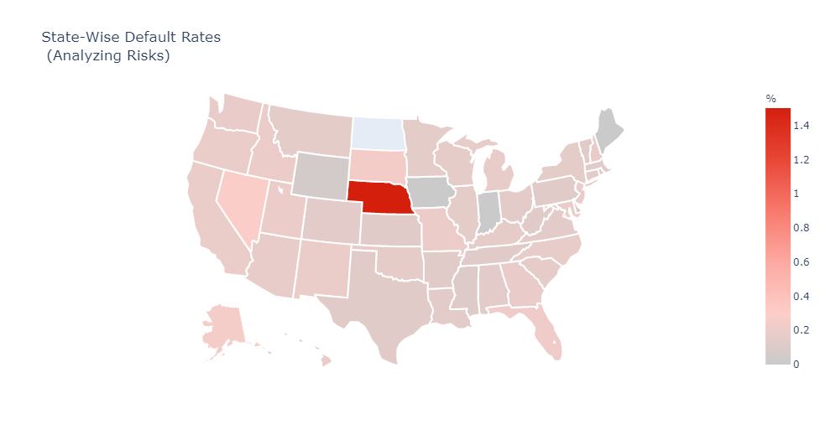
Issued Loans (State wise issued amounts)
State wise default rates (Analysing risks)
What makes defaulter ?
To get the model ready, we will drop the features with the following criteria
More than 50% of the data is missing
The feature would not have been available at the time of the loan application (for e.g. "issue_d").
Highly correlated predictors
Superfluous attributes
Zero (or nearly zero) variance predictors

Slide 9
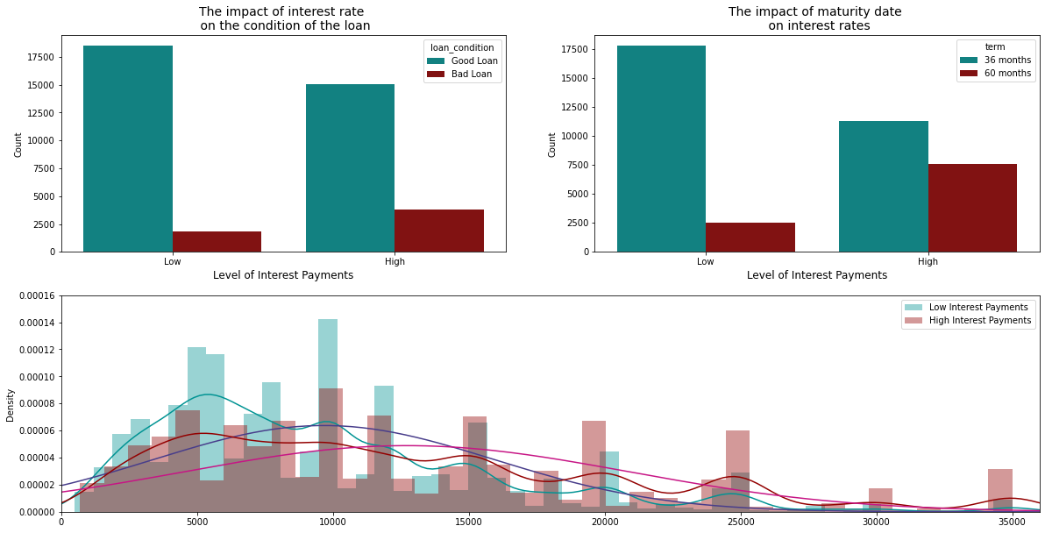

Slide 10
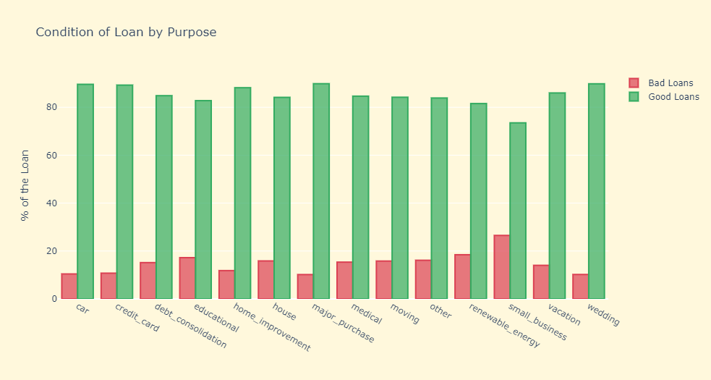
Purpose of loan and default rate

Slide 11
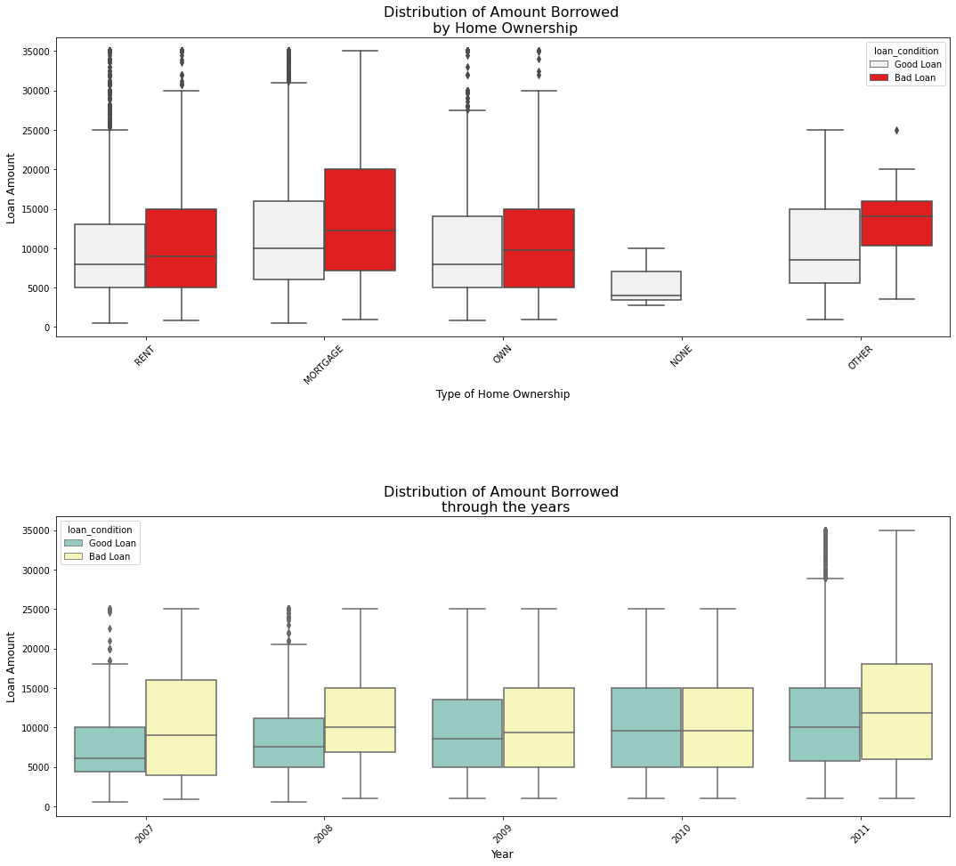

Slide 12
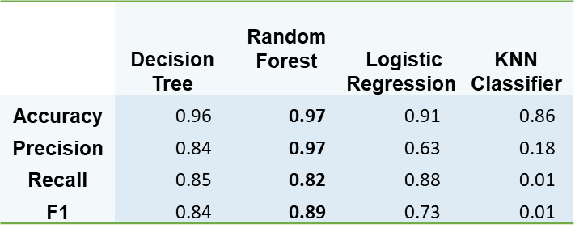
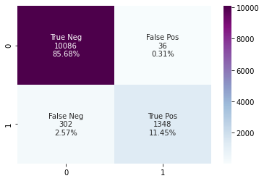
The random forest algorithm outperforms all other classification models, with over 97% accuracy

Slide 13
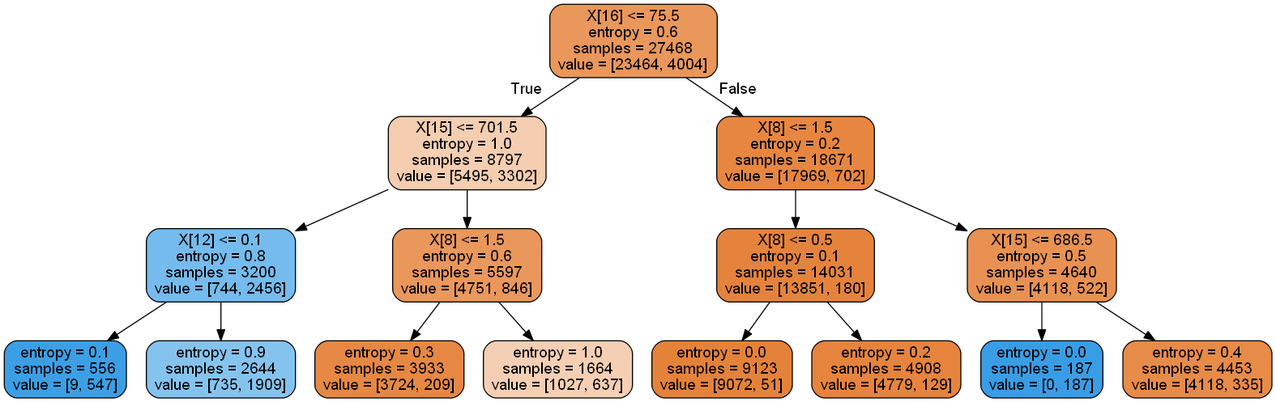
Business plan
The most important determinants – FICO score, months since last trade line, inquiries in last 6 months, interest rates, and number of bank account cards > 75% of the limit
We use the results from our random forest and logistic models to justify the criteria for loan approval.

Slide 14
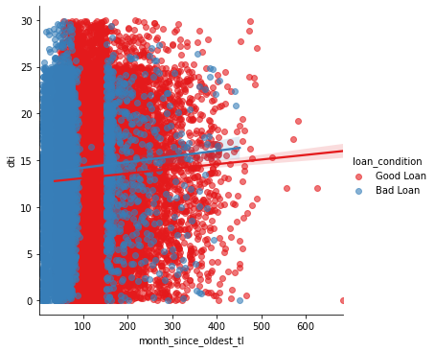
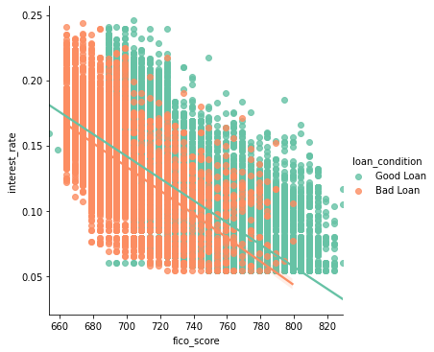
Identifying a good loan:
Maintain a FICO score greater than 700
Keep interest rates low, below 15%
Ensure a DTI ratio below 10
Over 100 months since last tradeline
This also shows that some factors are relatively unimportant in determining the default risk on a loan, i.e. the length of employment, income verification status, and home ownership status, among others

Slide 15
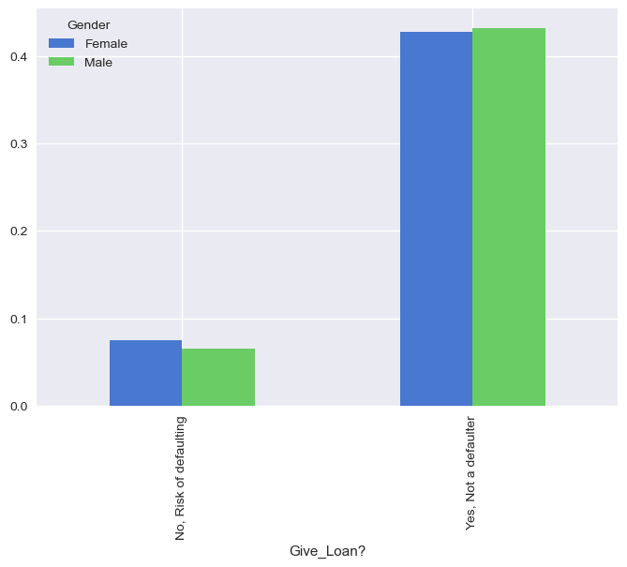
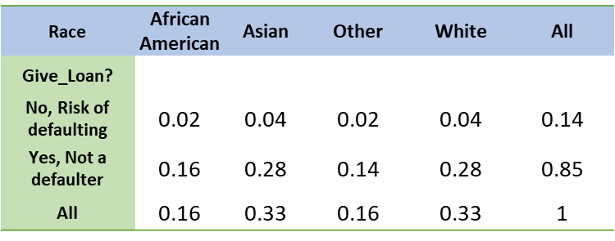
Two sensitive categories present in the data – gender and race
Does our model unintentionally discriminate?
Loans are distributed proportionately between different races and genders.

Slide 16
Conclusion
We did Exploratory data Analysis on the features of this dataset and saw how each feature is distributed.We did bivariate and multivariate analysis to see imapct of one another on their features using charts.
We analysed each variable to check if data is cleaned and normally distributed.
And based on the results, we assumed whether or not there is an association.
We calculated correaltion between independent variables and found that applicant income and loan amount have significant relation.
We created dummy variables for constructing the modelWe constructed models taking different variables into account and found through odds ratio that credit credit history is creating the most impact on loan giving decision
Finally, we got a model with coapplicant income and credit history as independent variable with highest accuracy. We tested the data and got the accuracy of 97 %

